Slide 1
Semaphore
Semaphore:
  An integer value used for signalling among processes.
Only three operations may be performed on a semaphore, all of which are atomic:
  initialize,
  Decrement (semWait)
  increment. (semSignal)
Notes:
1. A semaphore may be initialized to a nonnegative integer value.
2. The semWait operation decrements the semaphore value.
If the value becomes negative, then the process executing the semWait is blocked.
Otherwise, the process continues execution.
3. The semSignal operation increments the semaphore value.
If the resulting value is less than or equal to zero, then a process blocked by a semWait operation, if any, is unblocked.

Slide 2
1. A semaphore may be initialized to a nonnegative integer value.
2. The semWait operation decrements the semaphore value.
  If the value becomes negative, then the process executing the semWait is blocked.
  Otherwise, the process continues execution.
3. The semSignal operation increments the semaphore value.
  If the resulting value is less than or equal to zero, then a process blocked by a semWait operation, if any, is unblocked.

Slide 3
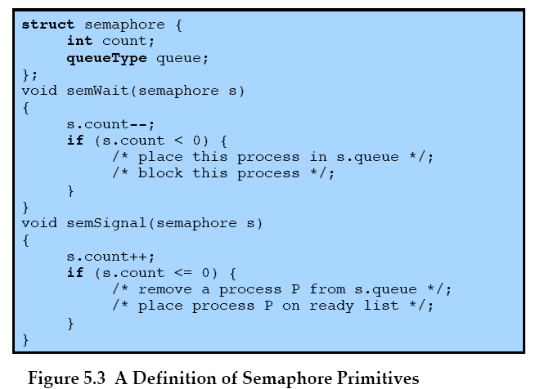
Semaphore Primitives
Notes:
An example of a semaphore

Slide 4
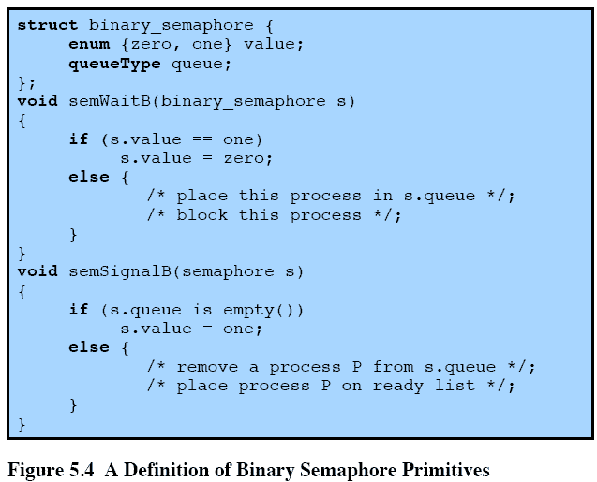
Binary Semaphore
Primitives
Notes:
A more restrictive semaphore which may only have the value of 0 or 1
A similar concept related to the binary semaphore is the mutex.
A key difference between the two is that the process that locks the mutex (sets the value to zero) must be the one to unlock it (sets the value to 1).
In contrast, it is possible for one process to lock a binary semaphore and for another to unlock it.

Slide 5
A more restrictive semaphore which may only have the value of 0 or 1
A similar concept related to the binary semaphore is the mutex.
  A key difference between the two is that the process that locks the mutex (sets the value to zero) must be the one to unlock it (sets the value to 1).
  In contrast, it is possible for one process to lock a binary semaphore and for another to unlock it.

Slide 6
Strong/Weak
Semaphore
A queue is used to hold processes waiting on the semaphore
  In what order are processes removed from the queue?
Strong Semaphores use FIFO
Weak Semaphores don’t specify the order of removal from the queue
Notes:
For both counting semaphores and binary semaphores, a queue is used to hold processes waiting on the semaphore.
The question arises of the order in which processes are removed from such a queue.
The fairest removal policy is first-in-first-out (FIFO):
The process that has been blocked the longest is released from the queue first; a semaphore whose definition includes this policy is called a strong semaphore.
A semaphore that does not specify the order in which processes are removed from the queue is a weak semaphore.

Slide 7
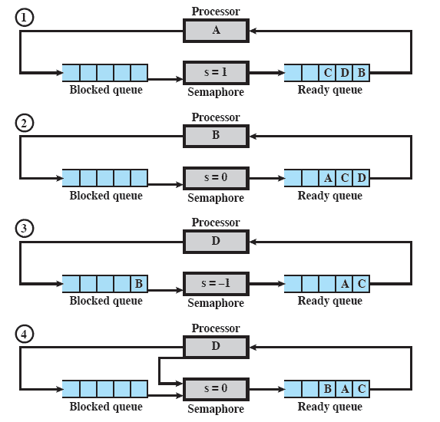
Example of Strong
Semaphore Mechanism
Notes:
Animated Slide – animation shows sections of the diagram to focus and remove distraction
Processes A, B, and C depend on a result from process D.
Initially (1), A is running;
B, C, and D are ready;
the semaphore count is 1, indicating that one of D’s results is available.
When A issues a semWait instruction on semaphore s, the semaphore decrements to 0, and A can continue to execute;
subsequently it rejoins the ready queue.
Then B runs (2), eventually issues a semWait instruction, and is blocked,
allowing D to run (3).
When D completes a new result, it issues a semSignal instruction,
which allows B to move to the ready queue (4).
D rejoins the ready queue and …

Slide 8
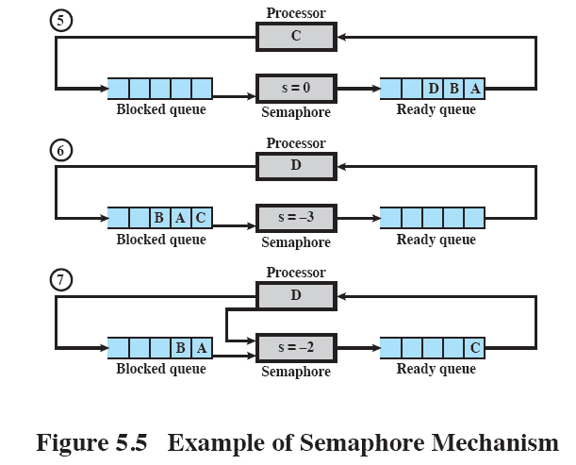
Example of Semaphore Mechanism
Notes:
C begins to run (5)
but is blocked when it issues a semWait instruction.
Similarly, A and B run and are blocked on the semaphore,
allowing D to resume execution (6).When D has a result, it issues a semSignal, which transfers C to the ready queue. Later cycles of D will release A and B from the Blocked state.

Slide 9
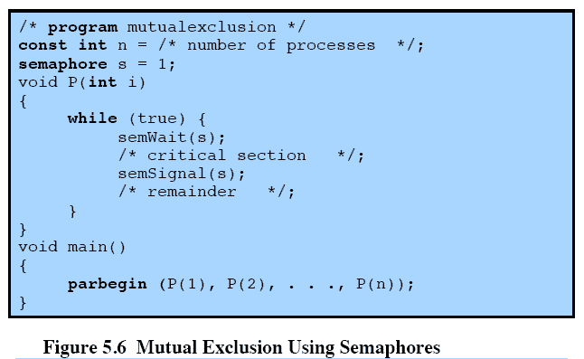
Mutual Exclusion Using Semaphores
Notes:
This shows a straightforward solution to the mutual exclusion problem using a semaphore
Consider n processes, identified in the array P(i), all of which need access to the same resource s.
Each process has a critical section used to access the resource.
In each process, a semWait(s) is executed just before its critical section.
If the value of s becomes negative, the process is blocked.
If the value is 1, then it is decremented to 0 and the process immediately enters its critical section;
because s is no longer positive, no other process will be able to enter its critical section.

Slide 10
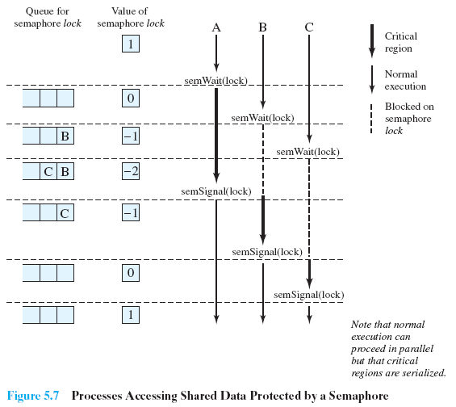
Processes Using
Semaphore
Notes:
Figure 5.7, shows a possible sequence for three processes using the mutual exclusion discipline of Figure 5.6.
Three processes (A,B, C) access a shared resource protected by the semaphore lock.
Process-A executes semWait(lock);
because the semaphore has a value of 1 at the time of the semWait operation, A can immediately enter its critical section and the semaphore takes on the value 0.
While A is in its critical section, both B and C perform a semWait operation and are blocked pending the availability of the semaphore.
When A exits its critical section and performs semSignal(lock), B, which was the first process in the queue, can now enter its critical section.

Slide 11
Producer/Consumer
Problem
General Situation:
  One or more producers are generating data and placing these in a buffer
  A single consumer is taking items out of the buffer one at time
  Only one producer or consumer may access the buffer at any one time
The Problem:
  Ensure that the Producer can’t add data into full buffer and consumer can’t remove data from empty buffer
Notes:
The general statement is this:
There are one or more producers generating some type of data (records, characters) and placing these in a buffer.
There is a single consumer that is taking items out of the buffer one at a time.
The system is to be constrained to prevent the overlap of buffer operations. That is, only one agent (producer or consumer) may access the buffer at any one time.
The problem is to make sure that the producer won’t try to add data into the buffer if it’s full and that the consumer won’t try to remove data from an empty buffer.
We will look at a number of solutions to this problem to illustrate both the power and the pitfalls of semaphores.

Slide 12
Functions
Assume an infinite buffer b with a linear array of elements
Producer | Consumer
while (true) { /* produce item v */ b[in] = v; in++; } | while (true) { while (in <= out) /*do nothing */; w = b[out]; out++; /* consume item w */ }

Slide 13
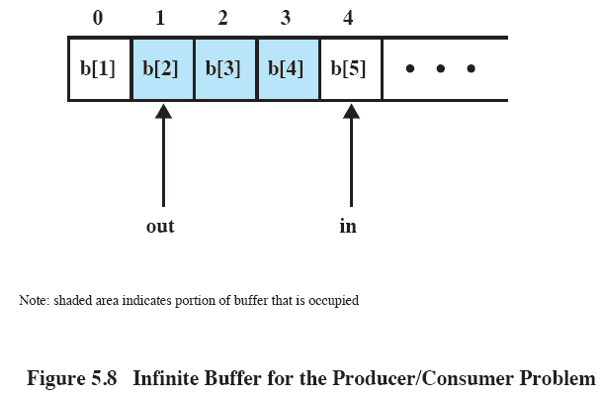
Buffer
Notes:
The producer can generate items and store them in the buffer at its own pace.
Each time, an index (in) into the buffer is incremented.
The consumer proceeds in a similar fashion but must make sure that it does not attempt to read from an empty buffer.

Slide 14
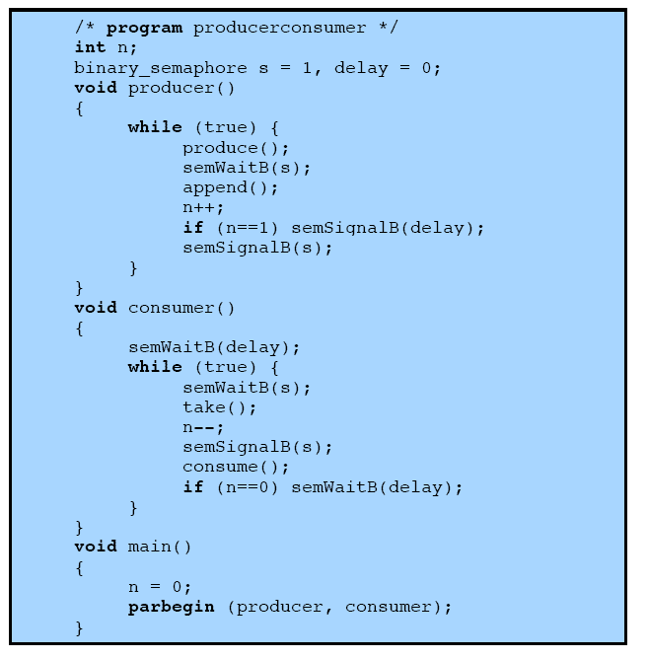
Incorrect Solution
Notes:
Rather than deal with the indices in and out, we can simply keep track of the number of items in the buffer, using the integer variable n (= in - out).
The semaphore s is used to enforce mutual exclusion;
the semaphore delay is used to force the consumer to semWait if the buffer is empty.

Slide 15
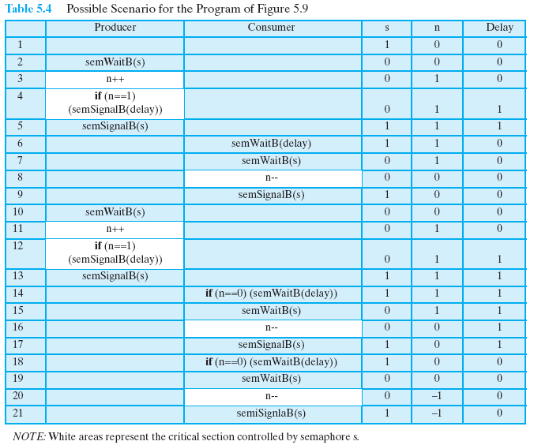
Possible Scenario
Notes:
There is, however, a flaw in this program.
When the consumer has exhausted the buffer, it needs to reset the delay semaphore so that it will be forced to wait until the producer has placed more items in the buffer.
This is the purpose of the statement: if n == 0 semWaitB (delay).
In line 14, the consumer fails to execute the semWaitB operation.
The consumer did indeed exhaust the buffer and set n to 0 (line 8),
but the producer has incremented n before the consumer can test it in line 14.
The result is a semSignalB not matched by a prior semWaitB.
The value of -1 for n in line 20 means that the consumer has consumed an item from the buffer that does not exist. It would not do simply to move the conditional statement inside the critical section of the consumer because this could lead to deadlock (e.g., after line 8 of the table).

Slide 16
When the consumer has exhausted the buffer, it needs to reset the delay semaphore so that it will be forced to wait until the producer has placed more items in the buffer.
  This is the purpose of the statement: if n == 0 semWaitB (delay).
In line 14, the consumer fails to execute the semWaitB operation.
The consumer did indeed exhaust the buffer and set n to 0 (line 8),
  but the producer has incremented n before the consumer can test it in line 14.
The result is a semSignalB not matched by a prior semWaitB.
  The value of -1 for n in line 20 means that the consumer has consumed an item from the buffer that does not exist. It would not do simply to move the conditional statement inside the critical section of the consumer because this could lead to deadlock (e.g., after line 8 of the table).

Slide 17
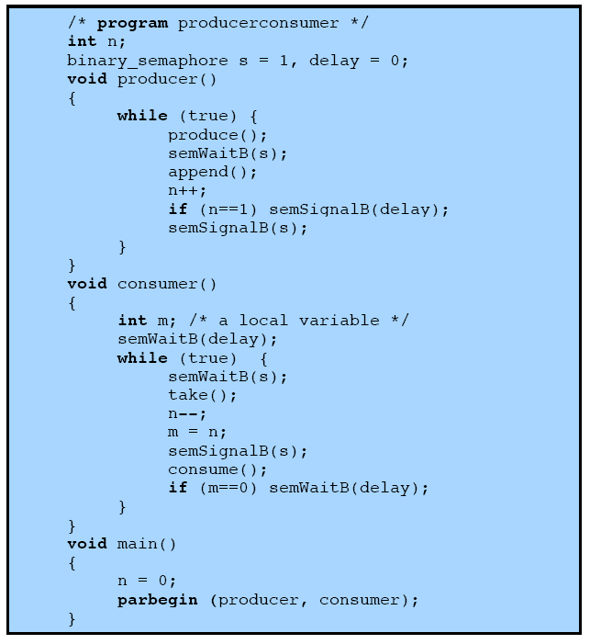
Correct Solution
Notes:
A fix for the problem is to introduce an auxiliary variable that can be set in the consumer’s critical section for use later on.

Slide 18
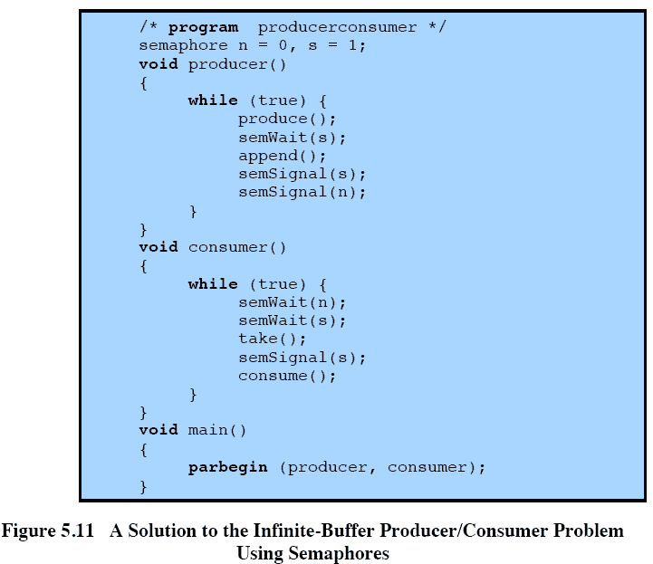
Semaphores
Notes:
A somewhat cleaner solution can be obtained if general semaphores (also called counting semaphores) are used
The variable n is now a semaphore.
Its value still is equal to the number of items in the buffer.
Suppose now that in transcribing this program, a mistake is made and the operations semSignal(s) and semSignal(n) are interchanged.
This would require that the semSignal(n) operation be performed in the producer’s critical section without interruption by the consumer or another producer.
Would this affect the program?
No, because the consumer must wait on both semaphores before proceeding in any case.

Slide 19
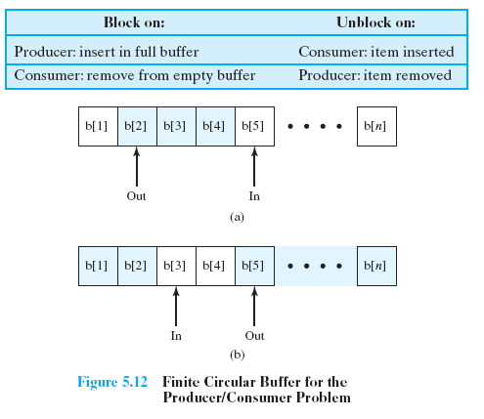
Bounded Buffer
Notes:
Finally, let us add a new and realistic restriction to the producer/consumer problem:
namely, that the buffer is finite.
The buffer is treated as a circular storage, and pointer values must be expressed modulo the size of the buffer.

Slide 20
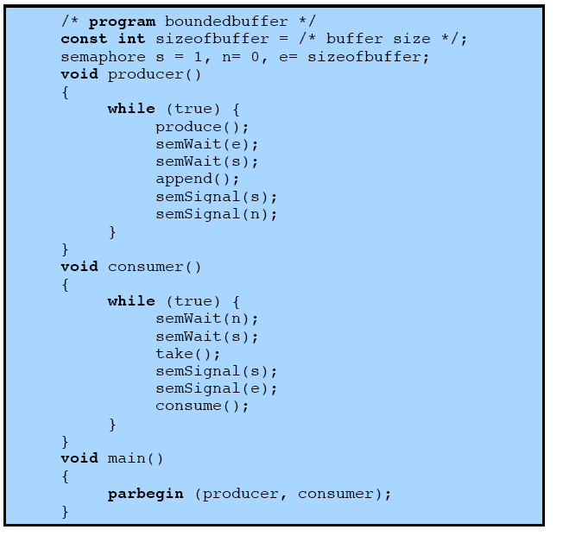
Semaphores

Slide 21
Functions in a
Bounded Buffer
.
Producer | Consumer
while (true) { /* produce item v */ while ((in + 1) % n == out) /* do nothing */; b[in] = v; in = (in + 1) % n } | while (true) { while (in == out) /* do nothing */; w = b[out]; out = (out + 1) % n; /* consume item w */ }

Slide 22
Monitors
The monitor is a programming-language construct that provides equivalent functionality to that of semaphores and that is easier to control.
Implemented in a number of programming languages, including
  Concurrent Pascal, Pascal-Plus,
  Modula-2, Modula-3, and Java.

Slide 23
Chief characteristics
Local data variables are accessible only by the monitor
Process enters monitor by invoking one of its procedures
Only one process may be executing in the monitor at a time
Notes:
The chief characteristics of a monitor are the following:
1. The local data variables are accessible only by the monitor’s procedures and not by any external procedure.
2. A process enters the monitor by invoking one of its procedures.
3. Only one process may be executing in the monitor at a time; any other processes that have invoked the monitor are blocked, waiting for the monitor to become available.

Slide 24
Synchronization
Synchronisation achieved by condition variables within a monitor
  only accessible by the monitor.
Monitor Functions:
  Cwait(c): Suspend execution of the calling process on condition c
  Csignal(c) Resume execution of some process blocked after a cwait on the same condition
Notes:
A monitor supports synchronization by the use of condition variables that are
contained within the monitor and accessible only within the monitor.
cwait(c): Suspend execution of the calling process on condition c.
The monitor is now available for use by another process.
csignal(c): Resume execution of some process blocked after a cwait on the same condition.
If there are several such processes, choose one of them; if there is no such process, do nothing.

Slide 25
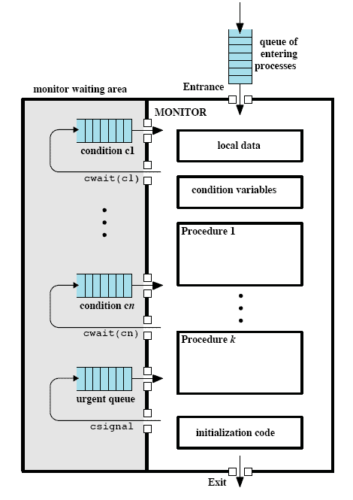
Structure of a Monitor
Notes:
Although a process can enter the monitor by invoking any of its procedures, we can think of the monitor as having a single entry point that is guarded so that only one process may be in the monitor at a time.
Other processes that attempt to enter the monitor join a queue of processes blocked waiting for monitor availability.
Once a process is in the monitor, it may temporarily block itself on condition x by issuing cwait(x);
it is then placed in a queue of processes waiting to re-enter the monitor when the condition changes, and resume execution at the point in its program following the cwait(x) call.
If a process that is executing in the monitor detects a change in the condition variable x, it issues csignal(x),
which alerts the corresponding condition queue that the condition has changed.

Slide 26
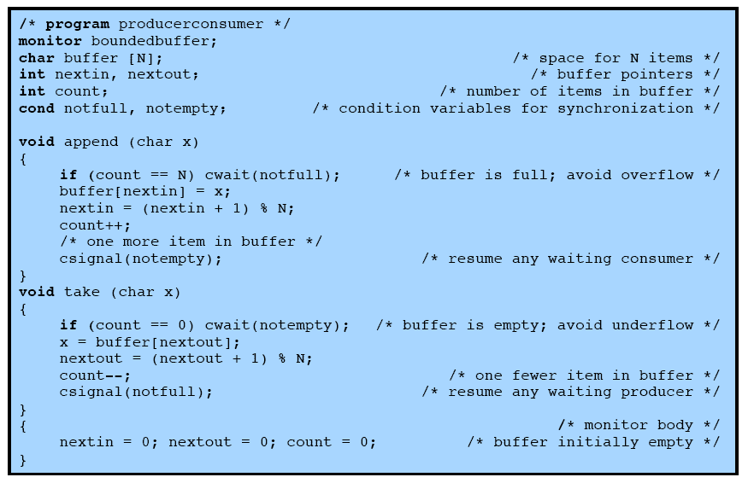
Bounded Buffer Solution
Using Monitor
Notes:
Returning to the bounded-buffer producer/consumer problem – this is a solution using a monitor.
The module, boundedbuffer, controls the buffer used to store and retrieve characters.
The monitor includes two condition variables (declared with the construct cond):
notfull is true when there is room to add at least one character to the buffer,
and notempty is true when there is at least one character in the buffer.
This example points out the division of responsibility with monitors compared to semaphores.
In the case of monitors, the monitor construct itself enforces mutual exclusion:
It is not possible for both a producer and a consumer simultaneously to access the buffer.
However, the programmer must place the appropriate cwait and csignal primitives inside the monitor to prevent processes from depositing items in a full buffer or removing them from an empty one.
In the case of semaphores, both mutual exclusion and synchronization are the responsibility of the programmer.

Slide 27
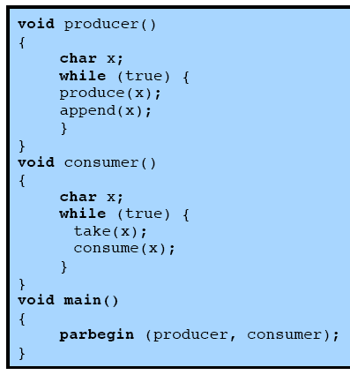
Solution Using Monitor
Notes:
Note here that a process exits the monitor immediately after executing the csignal function.
One language, ConcurrentPascal, insists that nothing follows a csignal call

Slide 28
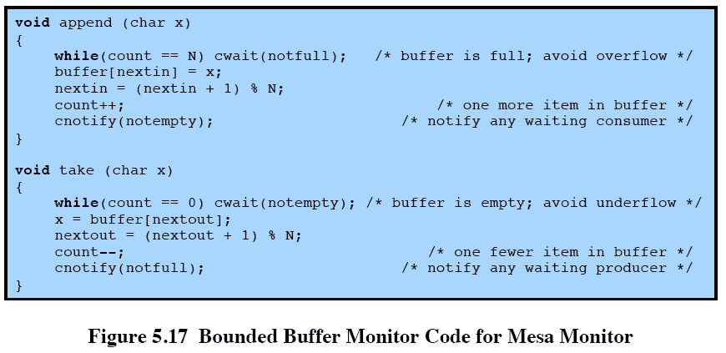
Bounded
Buffer Monitor
Notes:
Lampson and Redell developed an approach known as MESA
When a process executing in a monitor executes cnotify(x),
it causes the x condition queue to be notified, but the signalling process continues to execute.
The result of the notification is that the process at the head of the condition queue will be resumed at some convenient future time when the monitor is available.
However, because there is no guarantee that some other process will not enter the monitor before the waiting process, the waiting process must recheck the condition.
E.G. the procedures in the boundedbuffer monitor would now have the code in this slide

Slide 29
Process Interaction
When processes interact with one another, two fundamental requirements must be satisfied:
  synchronization and
  communication.
Message Passing is one solution to the second requirement
  It works with shared memory and with distributed systems
Notes:
When processes interact with one another, two fundamental requirements must be satisfied:
synchronization and
communication.
Processes need to be synchronized to enforce mutual exclusion;
cooperating processes may need to exchange information.
One approach to providing both of these functions is message passing.
Message passing has the further advantage that it lends itself to implementation in distributed systems as well as in shared-memory multiprocessor and uniprocessor systems.

Slide 30
Message Passing
The actual function of message passing is normally provided in the form of a pair of primitives:
send (destination, message)
receive (source, message)
Notes:
Emphasize that message-passing systems come in many forms. We provide a general introduction that discusses features typically found in such systems.
These primitives are a minimum set of operations needed for processes to engage in message passing.
A process sends information in the form of a message to another process designated by a destination.
A process receives information by executing the receive primitive, indicating the source and the message.

Slide 31
Synchronization
Communication requires synchronization
  Sender must send before receiver can receive
What happens to a process after it issues a send or receive primitive?
  Sender and receiver may or may not be blocking (waiting for message)
Notes:
The communication of a message between two processes implies some level of synchronization between the two: the receiver cannot receive a message until it has been sent by another process.
When a send primitive is executed in a process, there are two possibilities:
Either the sending process is blocked until the message is received,
or it is not.
Similarly, when a process issues a receive primitive, there are two possibilities:
If a message has previously been sent, the message is received and execution continues.
If there is no waiting message, then either
the process is blocked until a message arrives, or
the process continues to execute, abandoning the attempt to receive.

Slide 32
Blocking send,
Blocking receive
Both sender and receiver are blocked until message is delivered
Known as a rendezvous
Allows for tight synchronization between processes.
Notes:
Both the sender and receiver are blocked until the message is delivered;
this is sometimes referred to as a rendezvous.
This combination allows for tight synchronization between processes.

Slide 33
Non-blocking Send
More natural for many concurrent programming tasks.
Nonblocking send, blocking receive
  Sender continues on
  Receiver is blocked until the requested message arrives
Nonblocking send, nonblocking receive
  Neither party is required to wait
Notes:
Nonblocking send, blocking receive:
Although the sender may continue on, the receiver is blocked until the requested message arrives.
This is probably the most useful combination.
It allows a process to send one or more messages to a variety of destinations as quickly as possible.
A process that must receive a message before it can do useful work needs to be blocked until such a message arrives.
• Nonblocking send, nonblocking receive:
Neither party is required to wait.

Slide 34
Addressing
Sendin process need to be able to specify which process should receive the message
  Direct addressing
  Indirect Addressing
Notes:
it is necessary to have a way of specifying in the send primitive which process is to receive the message.
Similarly, most implementations allow a receiving process to indicate the source of a message to be received.

Slide 35
Direct Addressing
Send primitive includes a specific identifier of the destination process
Receive primitive could know ahead of time which process a message is expected
Receive primitive could use source parameter to return a value when the receive operation has been performed

Slide 36
Indirect addressing
Messages are sent to a shared data structure consisting of queues
Queues are called mailboxes
One process sends a message to the mailbox and the other process picks up the message from the mailbox
Notes:
A strength of the use of indirect addressing is that, by decoupling the sender and receiver, it allows for greater flexibility in the use of messages.

Slide 37
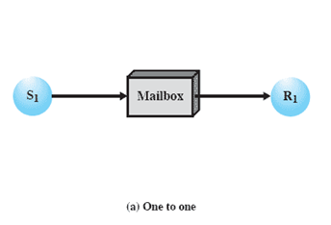
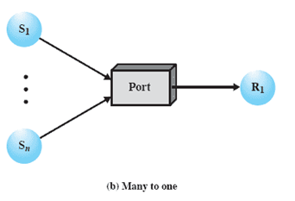
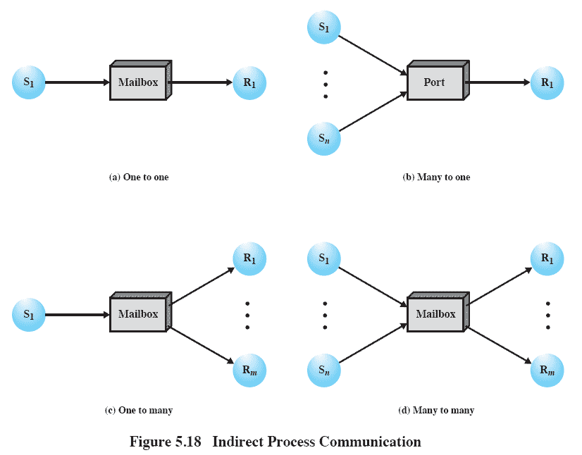
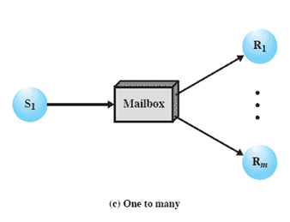
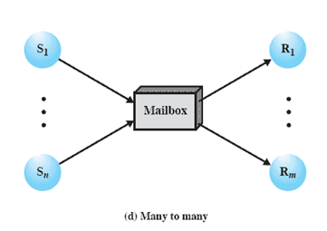
Indirect Process Communication
Notes:
Animated Slide – each item below is magnified for instructor to address separately
1) A one-to-one relationship
allows a private communications link to be set up between two processes.
This insulates their interaction from erroneous interference from other processes.
2) A many-to-one relationship is useful for client/server interaction;
one process provides service to a number of other processes.
In this case, the mailbox is often referred to as a port.
3) A one-to-many relationship allows for one sender and multiple receivers;
it is useful for applications where a message or some information is to be broadcast to a set of processes.
4) A many-to-many relationship
allows multiple server processes to provide concurrent service to multiple clients.
The association of processes to mailboxes can be either static or dynamic.
Ports are often statically associated with a particular process; that is, the port is created and assigned to the process permanently.
Similarly, a one-to-one relationship is typically defined statically and permanently. When there are many senders, the association of a sender to a mailbox may occur dynamically. Primitives such as connect and disconnect may be used for this purpose

Slide 38
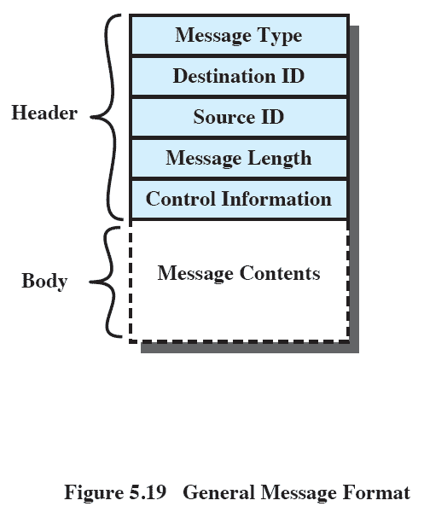
General Message Format
Notes:
The format of the message depends on the objectives of the messaging facility and whether the facility runs on a single computer or on a distributed system.
This is a typical message format for operating systems that support variable-length messages.
The message is divided into two parts:
a header, which contains information about the message.
The header may contain an identification of the source and intended destination of the message, a length field, and a type field to discriminate among various types of messages.
additional control information, e.g. pointer field so a linked list of messages can be created; a sequence number, to keep track of the number and order of messages passed between source and destination; and a priority field.
a body, which contains the actual contents of the message.

Slide 39
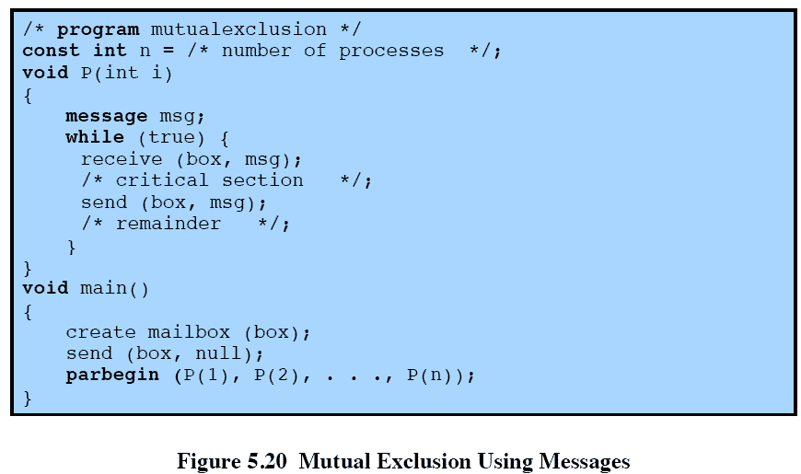
Mutual Exclusion Using Messages
Notes:
This is one way in which message passing can be used to enforce mutual exclusion.
We assume the use of the blocking receive primitive and the non-blocking send primitive.
This assumes that if more than one process performs the receive operation concurrently, then
• If there is a message, it is delivered to only one process and the others are blocked, or
• If the message queue is empty, all processes are blocked; when a message is available, only one blocked process is activated and given the message.

Slide 40
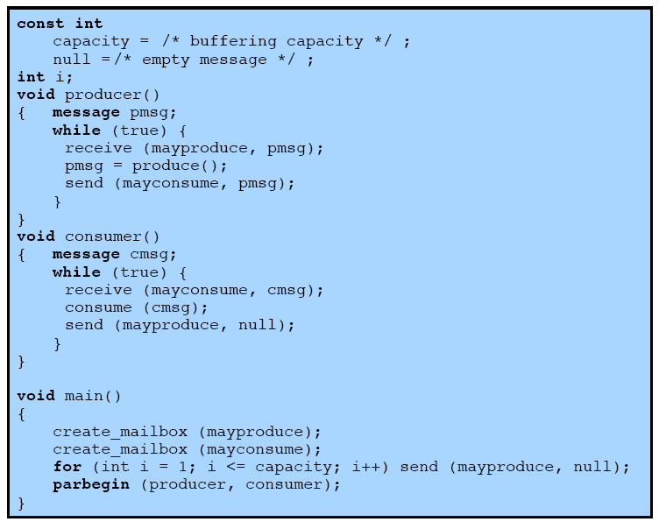
Producer/Consumer
Messages
Notes:
This is an example of the use of message passing to the bounded-buffer producer/consumer problem.
This program takes advantage of the ability of message passing to be used to pass data in addition to signals.
Two mailboxes are used.
As the producer generates data, it is sent as messages to the mailbox mayconsume.
As long as there is at least one message in that mailbox, the consumer can consume.
Hence mayconsume serves as the buffer; the data in the buffer are organized as a queue of messages.
The “size” of the buffer is determined by the global variable capacity. Initially, the mailbox mayproduce is filled with a
number of null messages equal to the capacity of the buffer. The number of messages in mayproduce shrinks with each production and grows with each consumption.

Slide 41
Readers/Writers Problem
A data area is shared among many processes
  Some processes only read the data area, some only write to the area
Conditions to satisfy:
  Multiple readers may read the file at once.
  Only one writer at a time may write
  If a writer is writing to the file, no reader may read it.
interaction of readers and writers.
Notes:
The readers/writers problem is:
There is a data area shared among a number of processes.
The data area could be a file, a block of main memory,or even a bank of processor registers.
There are a number of processes that only read the data area (readers) and a number that only write to the data area (writers).
The conditions that must be satisfied are as follows:
1. Any number of readers may simultaneously read the file.
2. Only one writer at a time may write to the file.
3. If a writer is writing to the file, no reader may read it.

Slide 42
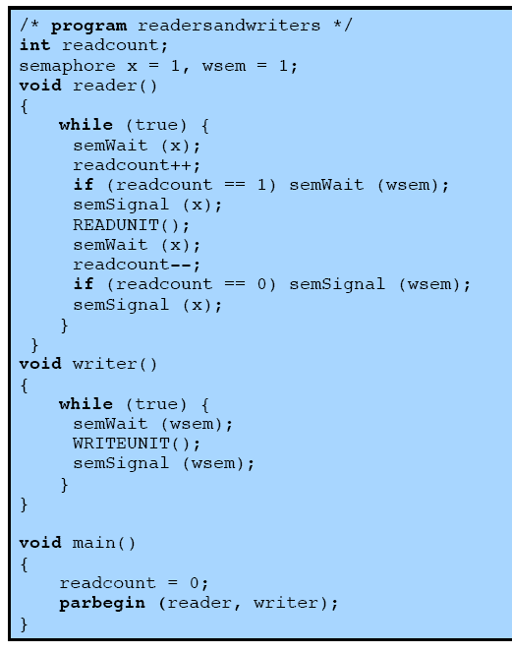
Readers have Priority
Notes:
This solution uses semaphores, showing one instance each of a reader and a writer; the solution does not change for multiple readers and writers.
Once a single reader has begun to access the data area, it is possible for readers to retain control of the data area as long as there is at least one reader in the act of reading.
Therefore, writers are subject to starvation.

Slide 43
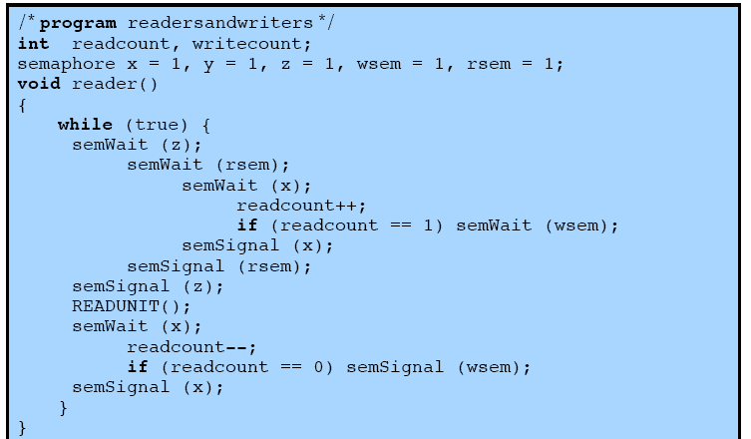
Writers have Priority
Notes:
This solution guarantees that no new readers are allowed access to the data area once at least one writer has declared a desire to write.
Continued on next slide

Slide 44
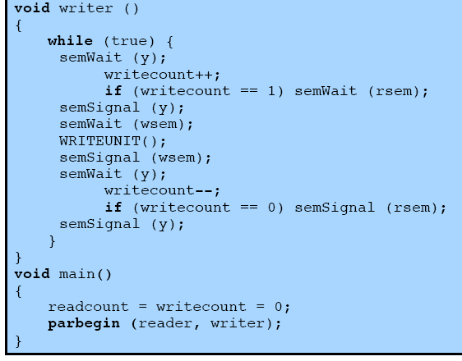
Writers have Priority

Slide 45
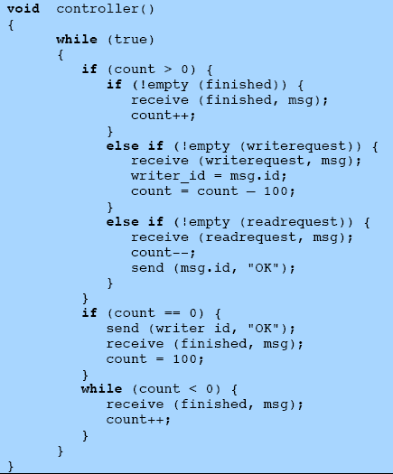
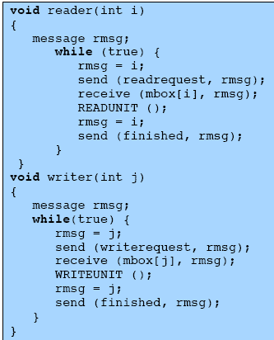
Message Passing
Notes:
This shows an alternative solution, which gives writers priority and which is implemented using message passing.

Slide 46
Controller process has access to the shared data area. Other processes wishing to access the data area send a request message to the controller, are granted access with an “OK” reply message and indicate completion of a access with a “finished” message.
The controller is equipped with three mailboxes, one for each type of message that it may receive.
The controller process services write request messages before read request messages to give priority.
For mutual exclusion “count” is used and initialized to some number greater than the max possible no of readers. Its 100. writers are with priority…..
If count>0, no writer is waiting, there may or may not bee readers active. Service all “finished” messages first to clear active readers, then service write requests and then read requests
If count=0, only request outstanding is write request, allow writer to proceed and wait for a “finished” message
If count<0, writer has made a request and is being made to wait to clear all active readers hence only “finished” messages should be served.

Slide 47
Message Passing

